Slide 1
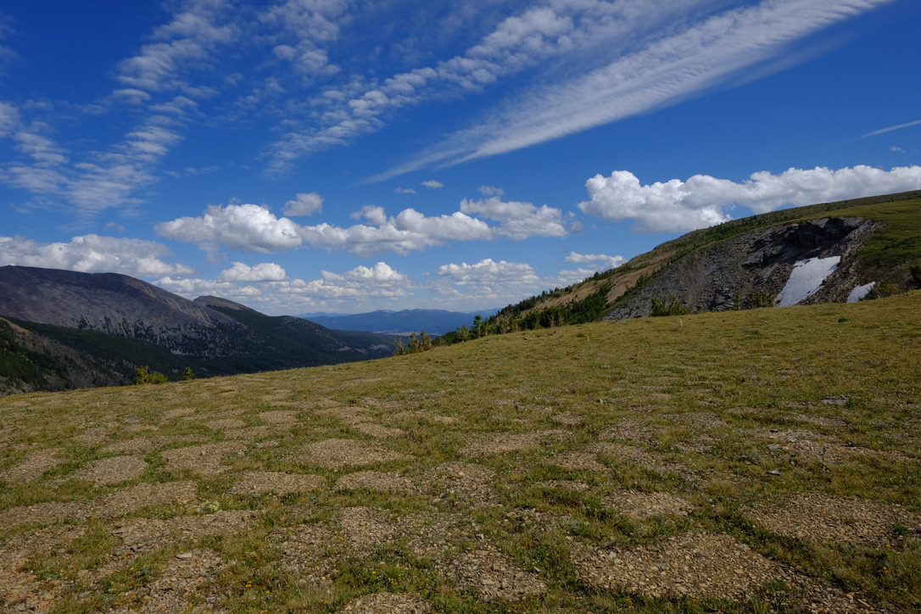
High Altitude Sensor Technology: HAST
Martha Apple¹, Kevin Negus², James Gallagher⁴,
Students: Jamison Ehlers², Justin Rubalcaba², Tyler Vendetti², Samuel Croft², Carson Fiechtner³,
¹Biological Sciences, ²Electrical Engineering, ³Computer Science, Montana Technological University, ⁴OPeNDAP

Slide 2
What is HAST?
A prototypical device for in-situ recording of soil temperature and humidity.
HAST logs data and sends it via Iridium satellites to a web host.
Rationale for HAST:
Soil temperature and moisture data are valuable in alpine ecology research on
snowfields, periglacial patterned ground, plants and climate change.
Alpine sites are often inaccessible due to snow and terrain.
Data must be collected on site sensors.
Access to sensor data is limited even though sensors can record year-round.
With HAST, we have the potential for greater accessibility for year-round data series and
improved understanding of climatic conditions in the alpine and other relatively inaccessible zones.

Slide 3
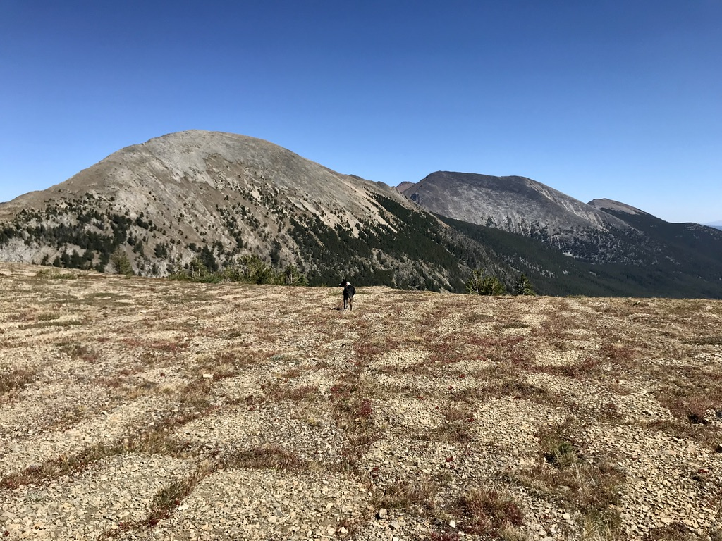
Do soil temperatures and plant functional traits vary with position on periglacial patterned ground?
The Goat Flat Alpine Tundra, 2837 m, 46° 3’ 17” N, 113° 16’ 43” W
Anaconda-Pintler Wilderness, SW Montana

Slide 4
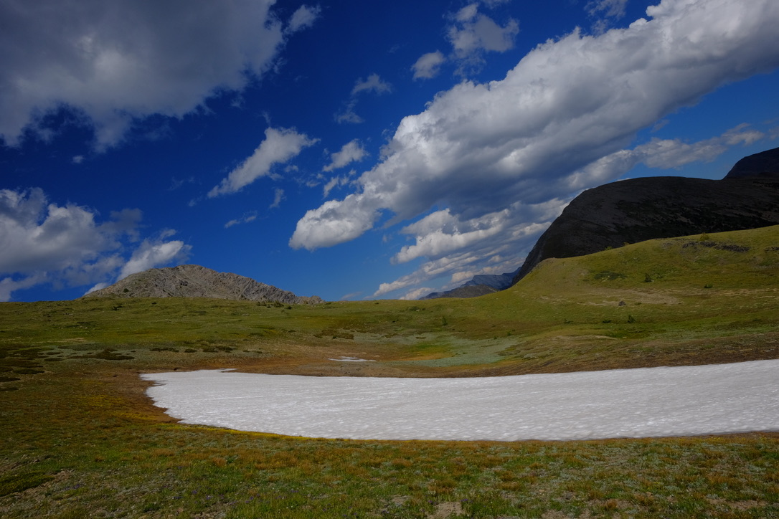
Late Summer Snowfield, Goat Flat Alpine Tundra
Snowfields used to last through the summer but now they do not.
What are the soil temperatures where snowfields are retreating?

Slide 5
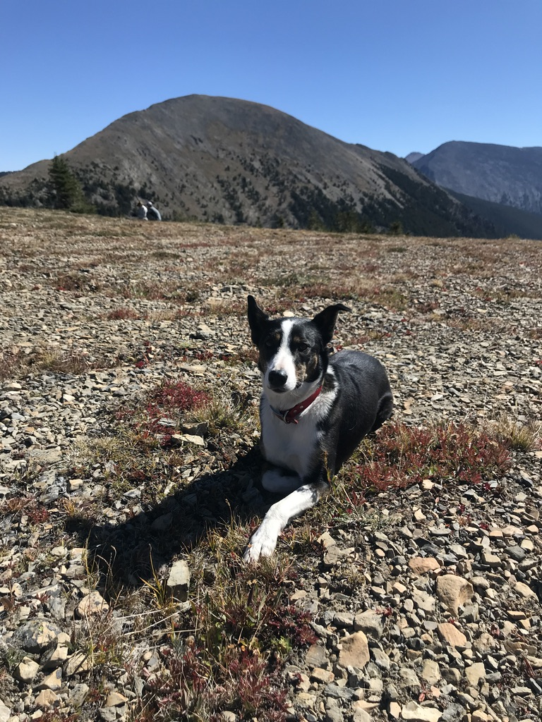
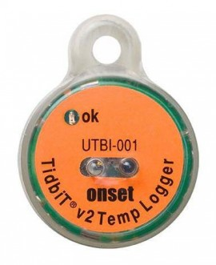
CURRENT FIELD METHODS:
On the Edges and Centers of Polygons,
Soil Temperature:
Hobo-Onset Temperature Sensors (UTBI-001), n = 12
5-10 cm beneath the soil surface
Temperatures recorded hourly, 2018-21.
Plant Species and Functional Traits:
Surveyed their distribution in quadrats
Recorded percent cover,
Calculated relative percent cover (RPC)
RPC = % cover species or trait/total % cover of quadrat.

Slide 6
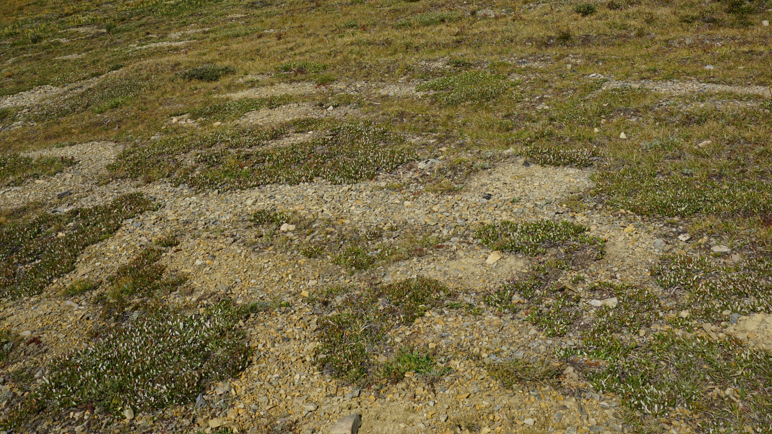
When sensors are set 5-10 cm beneath the soil on patterned ground, how is it possible to relocate them to retrieve data?

Slide 7
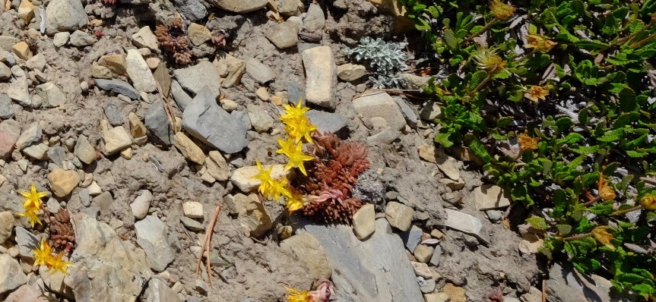
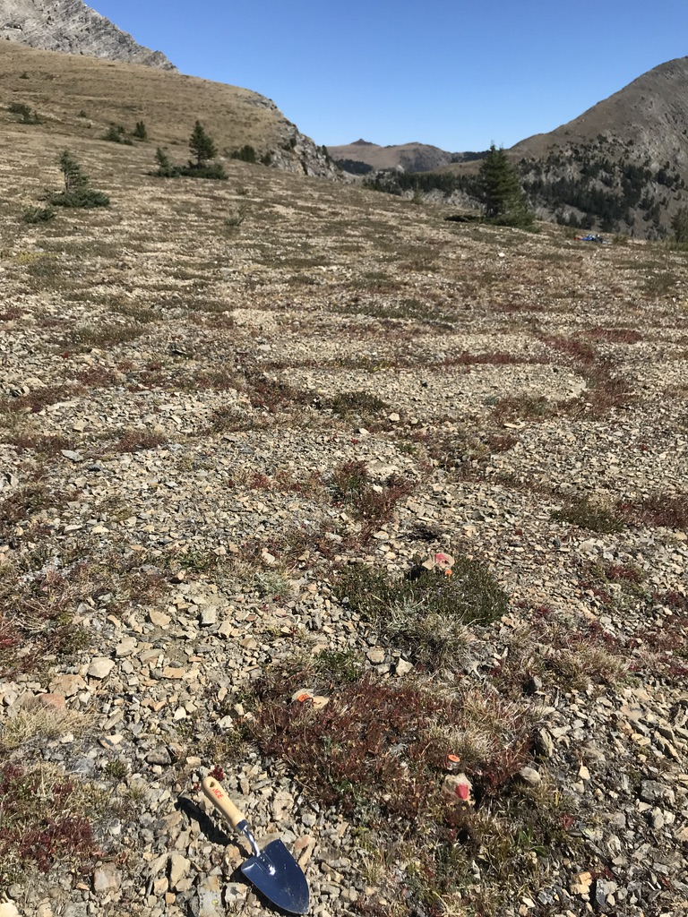
RESULTS:
Edges of polygons:
Total percent cover was high
Higher RPCs:
Dwarf shrubs
Dryas octopetala and Salix arctica
Tree seedlings
Picea engelmanii
Centers of polygons:
Total percent cover was low
Higher RPCs for:
Drought tolerant CAM * plants
CAM = Crassulacean Acid Metabolism
Sedum lanceolatum, Sedum roseum
Clonal mechanisms:
Stolon production
Vivipary (clones instead of seeds)
Polygonum viviparum

Slide 8
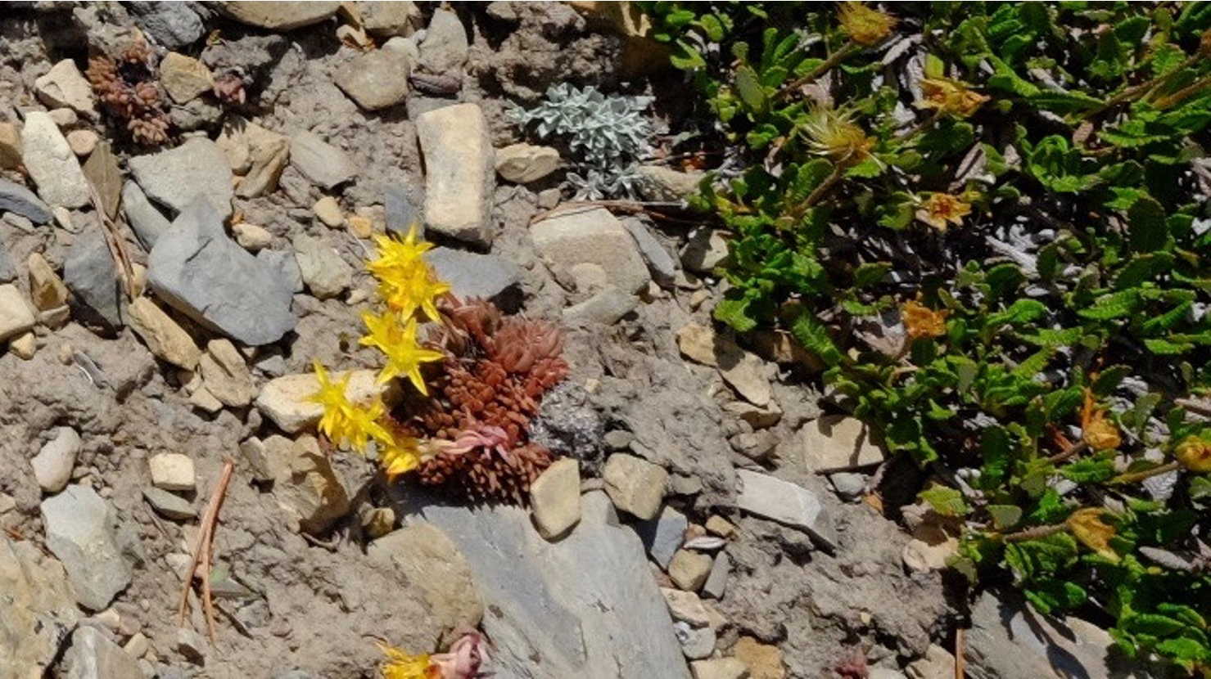
Polygon centers:
Higher Relative Percent Cover
Sedum lanceolatum, a CAM plant,
Polygon edges:
Higher Relative Percent Cover
Dryas octopetala, an evergreen dwarf shrub

Slide 9
 | Goat Flat Soil Temperature °C, 2018-19
Polygon | Maximum | Minimum | Average | Range
Center (Blue Line) | 22.01 +/- 2.07 | -10.59 +/- 0.27 | 0.54 +/- 0.07 | 32.61 +/- 1.98
Edge (Green Line) | 17.76 +/- 0.24 | -11.06 +/- 0.32 | 0.64 +/- 0.12 | 28.83 +/- 0.48

Slide 10
Snowfield Soil Temperature Sensor, 2019-21,
Straight Line at 0° C Indicates Snow Cover

Slide 11
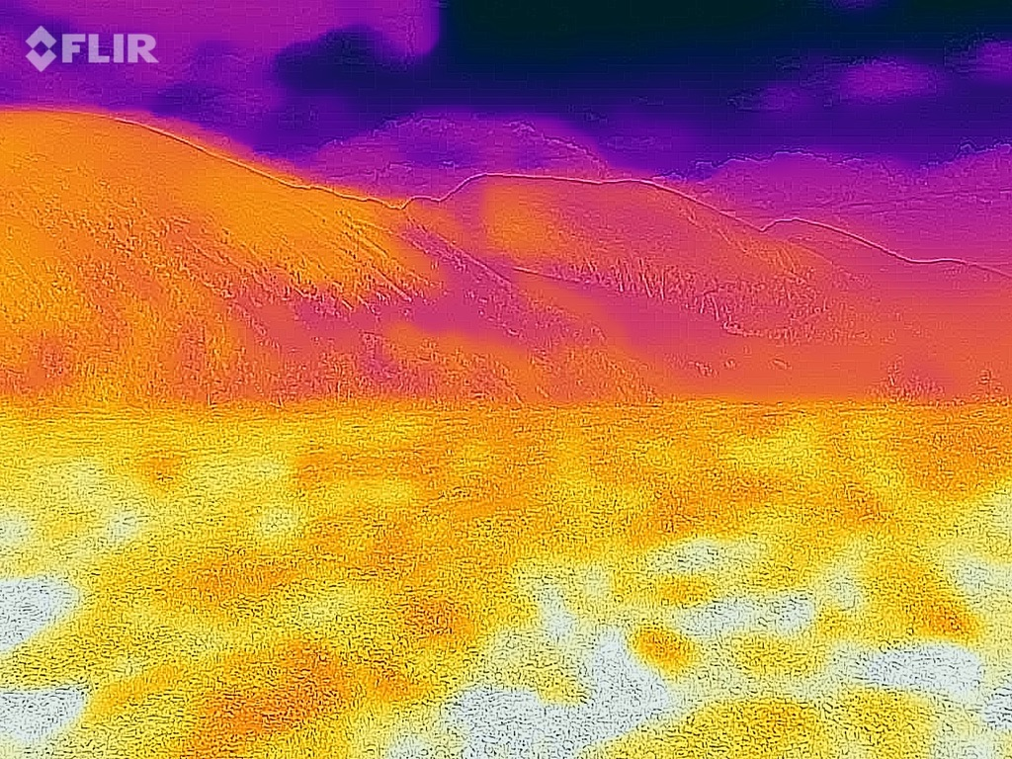
FLIR Thermographs of Polygon Surface Temperatures, °C, n = 50
Polygon | Maximum | Minimum | Average
Centers | 37.15 +/- 0.89 | 29.39 +/- 0.71 | 32.90 +/- 0.87
Edges | 31.17 +/- 0.84 | 24.76 +/- 0.71 | 26.92 +/- 0.87

Slide 12
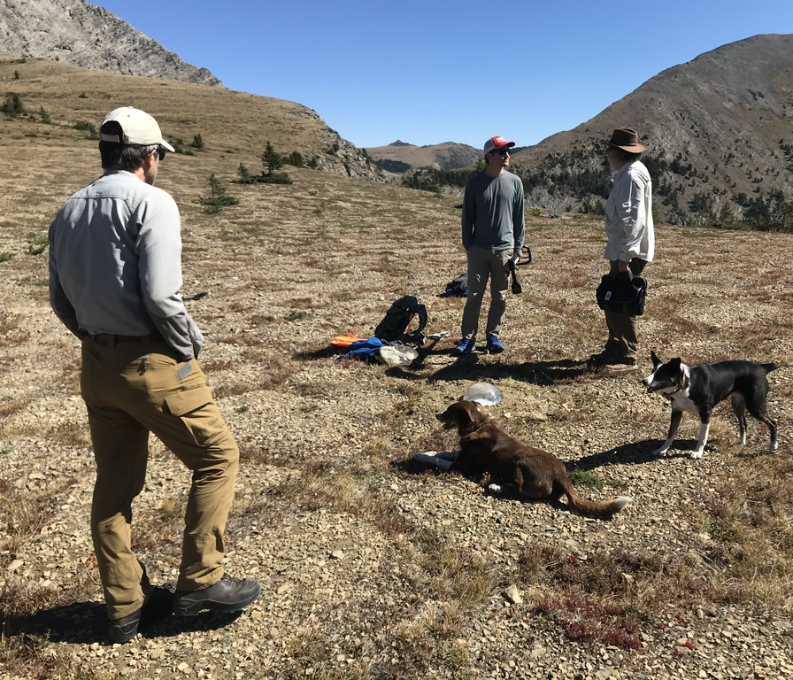
HAST!

Slide 13
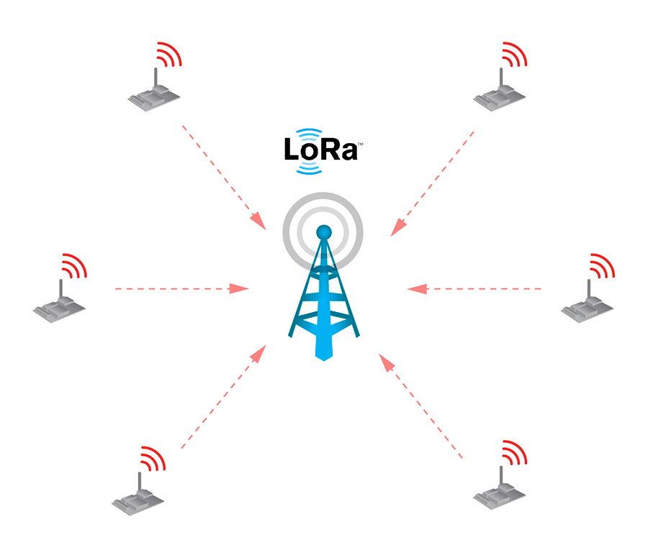
HAST Sensor Network Topology
Main/Sensor star and/or mesh topology
Sensor nodes
Collect data (temperature, soil moisture, etc.)
Use LoRa radio to send data to Master
Main node
Receives data from sensors using LoRa
Will include temperature, etc., sensing
Forward data to ‘Application Server’ via Iridium satellites and the Internet.
Sensor node
Master node
Internet

Slide 14
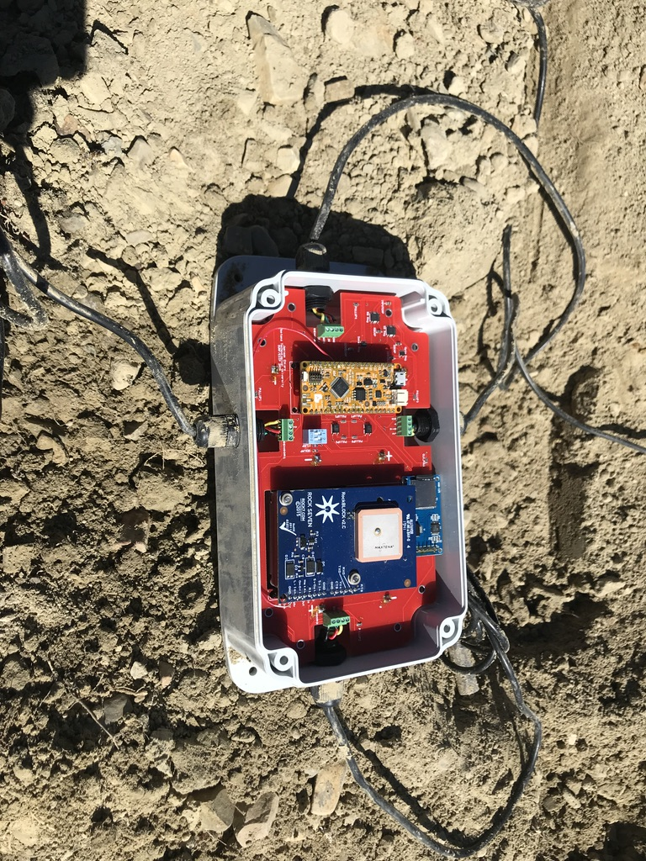
Wires lead to sensors
SD Card and Holder
RocketScream (Arduino)
RockBLOCK
(Iridium Modem)
Printed Circuit Board
(Batteries Underneath)
IP68 Case
HAST MAIN NODE

Slide 15
In the HAST System main node:
The RocketScream controls the main node, providing power management, a real-time clock, and the Arduino coding libraries to operate each of the other components. The usual operating mode (standby) of the microcontroller will draw around 20 uA, increasing to 20 mA when active.
The RockBlock is a satellite modem, able to connect to a moving satellite in orbit around Earth, and can send an email containing a “Twitter length” string of data
The SD card reader stores data onto a temperature rated SD card, if the RockBlock is unable to establish a satellite connection.
The SHT10 sensor reads temperature and soil humidity. For the final system, multiple sensors will be implemented.
The lithium-thionyl batteries were chosen for their constant voltage performance over time, as well as their projected battery life. They are non-rechargeable.
The IP68 rated cable glands and NEMA case were chosen for their safety rating of dust ingress and moisture incursion protection.

Slide 16
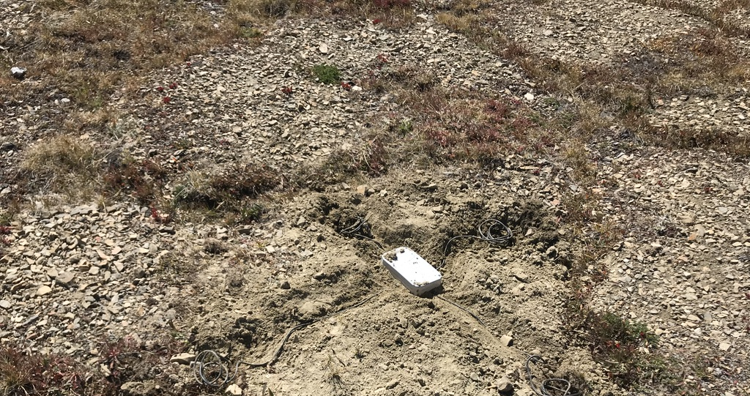

Slide 17
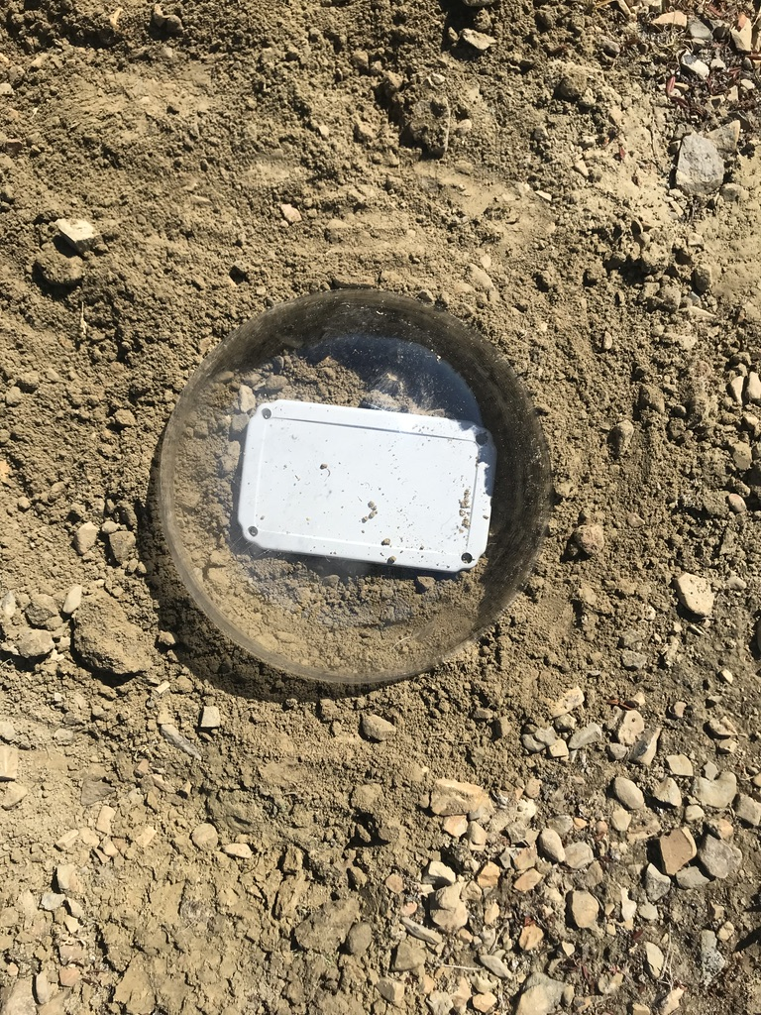
The clear acrylic dome decreases the attenuating effects of dirt and snow on the radio energy.

Slide 18
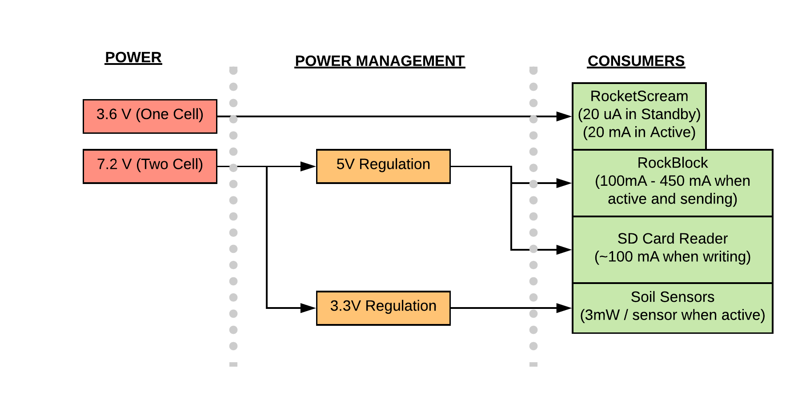
Power Use of Main Node

Slide 19
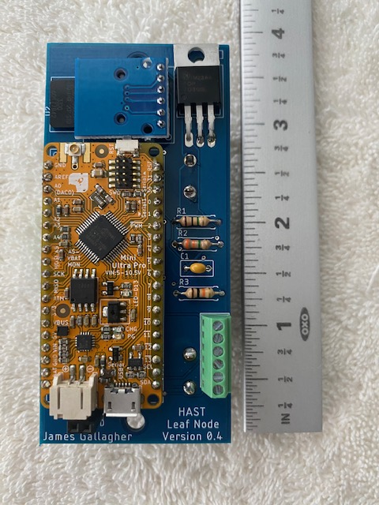
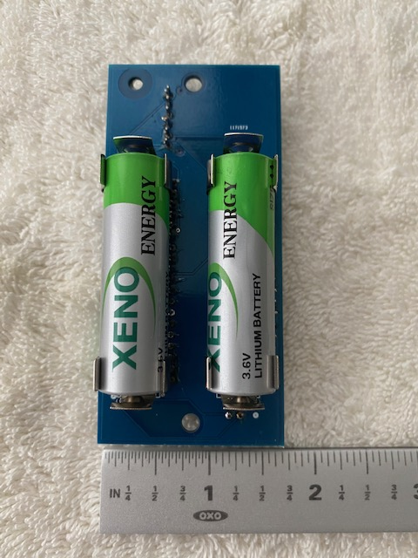
Current leaf node sensor design – PCB version
TOP
BOTTOM

Slide 20
Current leaf node sensor design
A prototype leaf node has been deployed alongside a traditional sensor system for comparison, and it recorded/transmitted 270,000+ readings.
The leaf node design uses:
Lithium Thionyl-Chloride (Li/SOCl₂) batteries.
Off-the-shelf temperature and humidity sensor (SHT-30).
The RadioHead* LoRa software library, providing support for reliable networking.
An SD card for redundant data storage
Source code at: github.com/jgallagher59701/Soil_moisture
*www.airspayce.com/mikem/arduino/RadioHead/

Slide 21
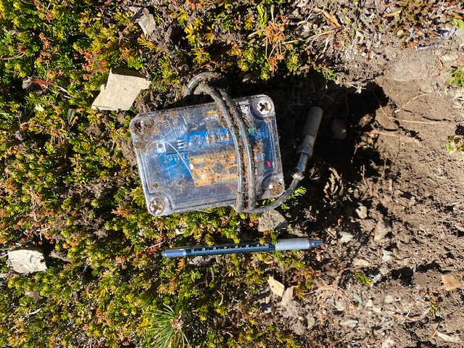
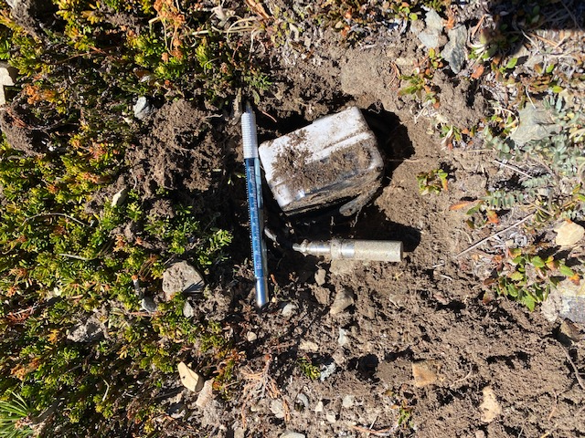
Leaf node deployment
This prototype unit has been left at the site to over-winter. Other nodes are deployed in Butte where they can be more easily accessed and monitored.

Slide 22
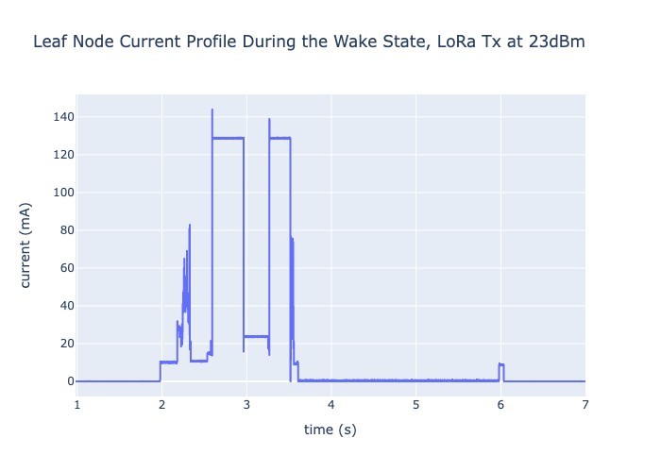
Leaf node power consumption
Wake-state power use shown at right
Sleep power use is 18.5µA
Estimated best-case battery life is 11.8 years (hourly sensor readings and data transmission)*.
*Jupyter notebook: https://github.com/jgallagher59701/HAST_leaf_node_data/blob/main/Compute_Leaf_Node_Current_2.ipynb

Slide 23
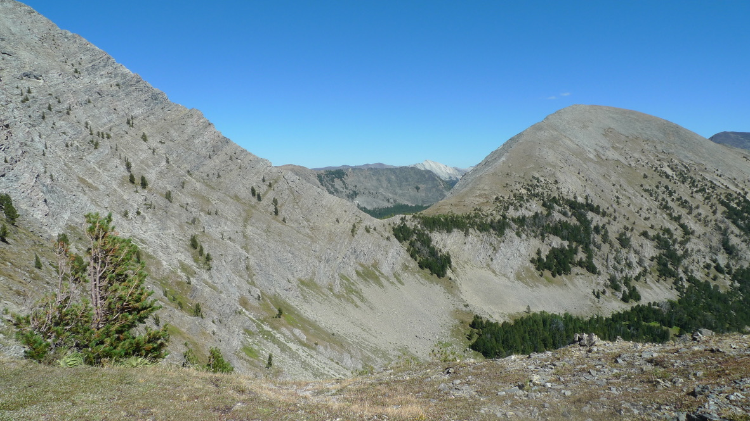
Acknowledgements: Montana Technological University (Biological Sciences and Electrical Engineering). This work is based on funding provided by the ESIP Lab with support from the National Aeronautics and Space Administration (NASA), National Oceanic and Atmospheric Administration (NOAA) and the United States Geologic Survey (USGS).

